Slide 1
Data Analytics
Artificial Neural Networks

Slide 2
Artificial Neural Networks (ANN)
Example
Output Y is 1 if at least two of the three inputs are equal to 1, and -1 otherwise

Slide 3
Artificial Neural Networks (ANN)
Y = sign(0.3X₁ + 0.3X₂ + 0.3X₃ – 0.4)
where sign(x)=1 if x>=0 and -1 if x<0
Other coefficients would also work for this example

Slide 4
Artificial Neural Networks (ANN)
Model is an assembly of inter-connected nodes and weighted links
Output node sums up each of its input value according to the weights of its links
Compare output node against some threshold/bias t
Perceptron Model

Slide 5
Artificial Neural Networks (ANN)
In a real situation, we may have a set of “training data”
Values of X₁, X₂, X₃ and Y for a number of cases
We want the weights, w_{i} and bias t such that they give the most accurate predictions of Y, given inputs X₁, X₂ and X₃
Perceptron Model

Slide 6
General Structure of ANN
Training an ANN means learning the weights of the neurons

Slide 7
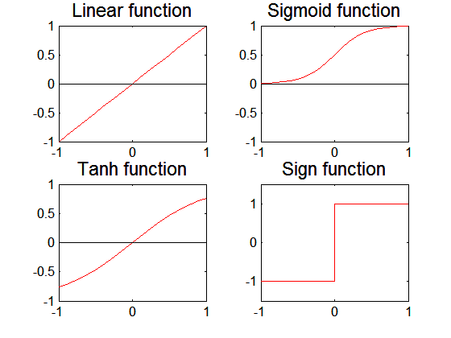
Artificial Neural Networks (ANN)
Various types of neural network topology
single-layered network (perceptron) versus multi-layered network
Feed-forward versus recurrent network
Various types of activation functions (f)

Slide 8
Perceptron
Single layer network
Contains only input and output nodes
Activation function: f = sign(w•x)
Applying model is straightforward
X₁ = 1, X₂ = 0, X₃ = 1 means y = sign(0.2) = 1

Slide 9
Perceptron Learning Rule
But how can an ANN learn the weights that are best for a particular dataset?
It uses an algorithm, as below
Initialize the weights (w₀, w₁, …, w_{d})
Decide on learning rate, λ
Repeat
For each training example (x_{i}, y_{i})
Compute f(w, x_{i})
Update the weights:
Continue until stopping condition is met

Slide 10
Example of Perceptron Learning
For the Perceptron Model (see right), we convert the “-t” part into w₀ and X₀
w₀ = -t, X₀ = 1
Perceptron Model

Slide 11
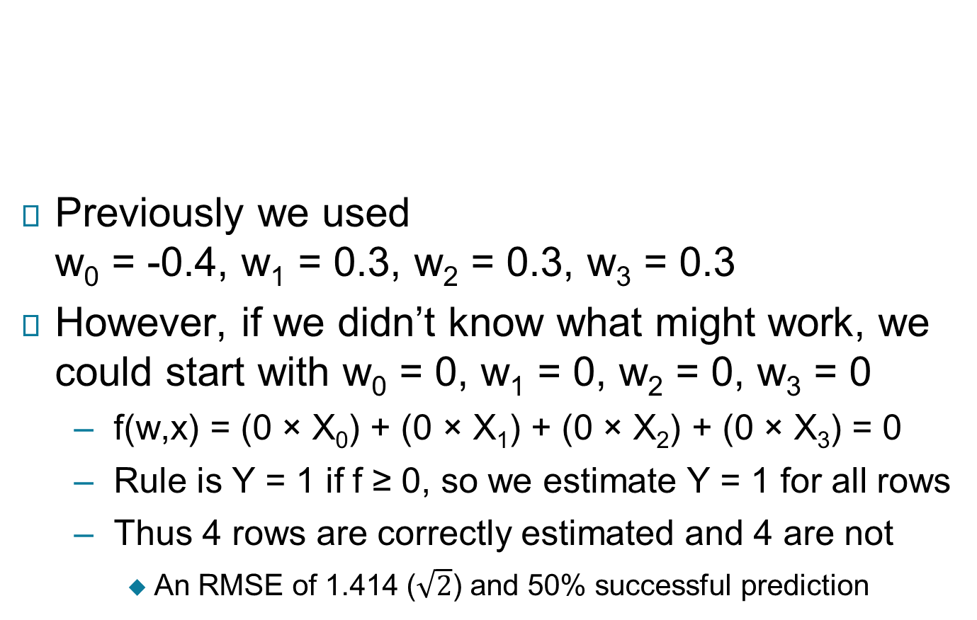
Example of Perceptron Learning
Previously we used w₀ = -0.4, w₁ = 0.3, w₂ = 0.3, w₃ = 0.3
However, if we didn’t know what might work, we could start with w₀ = 0, w₁ = 0, w₂ = 0, w₃ = 0
f(w,x) = (0 × X₀) + (0 × X₁) + (0 × X₂) + (0 × X₃) = 0
Rule is Y = 1 if f ≥ 0, so we estimate Y = 1 for all rows
Thus 4 rows are correctly estimated and 4 are not
An RMSE of 1.414 ($\sqrt{2}$) and 50% successful prediction

Slide 12
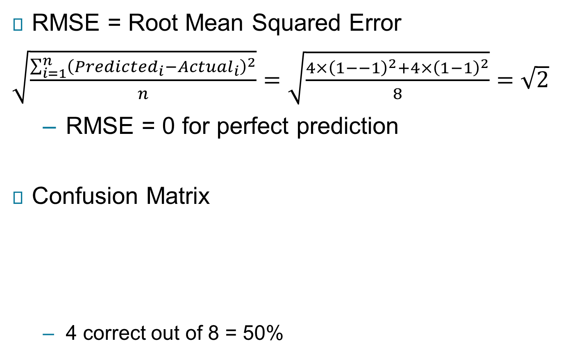
Measures of Accuracy
RMSE = Root Mean Squared Error
$\sqrt{\frac{\sum_{i=1}^{n}{{\left({Predicted}_{i}−{Actual}_{i}\right)}^{2}}}{n}}=\sqrt{\frac{{4×\left(1−−1\right)}^{2}+4×{\left(1−1\right)}^{2}}{8}}=\sqrt{2}$
RMSE = 0 for perfect prediction
Confusion Matrix
4 correct out of 8 = 50%
 | Actual
Predicted | -1 | 1
-1 | 0 | 0
1 | 4 | 4

Slide 13
Example of Perceptron Learning
We start with “Epoch 0”
The initial state, using starting values for weights
For the first row of data, we update w₀
w₀⁽⁰⁾ = 0, λ = 0.1
X₀ = 1, real Y = -1, estimated Y = f = 1
w₀⁽¹⁾ = 0 + 0.1*[-1 - 1]*1 = -0.2

Slide 14
Example of Perceptron Learning
Still with the first row of data, we then update w₁, w₂, w₃
w₁⁽⁰⁾ = 0, w₂⁽⁰⁾ = 0, w₃⁽⁰⁾ = 0
λ = 0.1
X₁ = 1, X₂ = 0, X₃ = 0
Real Y = -1, estimated Y = f = 1
w₁⁽¹⁾ = 0 + 0.1*[-1 - 1]*1 = -0.2
w₂⁽¹⁾ = 0 + 0.1*[-1 - 1]*0 = 0
w₃⁽¹⁾ = 0 + 0.1*[-1 - 1]*0 = 0

Slide 15
Example of Perceptron Learning
We then use the new w₁, w₂, w₃ when updating row 2
w₀⁽¹⁾ = -0.2, w₁⁽¹⁾ = -0.2, w₂⁽¹⁾ = 0, w₃⁽¹⁾ = 0
X₀ = 1, X₁ = 1, X₂ = 0, X₃ = 1
λ = 0.1, real Y = 1, est. Y = -1
w₀⁽²⁾ = -0.2 + 0.1*[1 - (-1)]*1 = 0
w₁⁽²⁾ = -0.2 + 0.1*[1 - (-1)]*1 = 0
w₂⁽²⁾ = 0 + 0.1*[1 - (-1)]*0 = 0
w₃⁽²⁾ = 0 + 0.1*[1 - (-1)]*1 = 0.2

Slide 16
Example of Perceptron Learning
For row 3, Y = f so nothing changes
w₀⁽²⁾ = 0, w₁⁽²⁾ = 0, w₂⁽²⁾ = 0, w₃⁽²⁾ = 0.2
X₀ = 1, X₁ = 1, X₂ = 1, X₃ = 0
λ = 0.1, real Y = 1, est. Y = 1
w₀⁽³⁾ = 0 + 0.1*[1 - 1)]*1 = 0
w₁⁽³⁾ = 0 + 0.1*[1 - 1]*1 = 0
w₂⁽³⁾ = 0 + 0.1*[1 - 1]*0 = 0
w₃⁽³⁾ = 0.2 + 0.1*[1 - 1]*1 = 0.2

Slide 17
Example of Perceptron Learning
Completing all rows of the data, we end the first “Epoch”

Slide 18
Example of Perceptron Learning
We then use the weights at the end of this Epoch as starting values to go through all the rows of the data again to complete Epoch 2

Slide 19
Example of Perceptron Learning
We then use the weights at the end of Epoch 2 as starting values to go through all the rows of the data again to complete Epoch 3

Slide 20
Example of Perceptron Learning
We carry on until the weights are the same at the end of an Epoch as at the end of the previous Epoch

Slide 21
Example of Perceptron Learning
Different starting weights can lead to different final weights
There may be several optimal solutions
In more complex situations it may not be possible to reach 100% correct and RMSE = 0

Slide 22
Multi-layer Neural Network
To cope with more complex problems, we can add “hidden layers” to our network
intermediary layers between input & output layers
Can also use activation functions that are more general than sign (e.g. sigmoid, linear, tanh)
A multi-layer neural network can solve any type of classification task involving nonlinear decision surfaces

Slide 23
Multi-layer Neural Network

Slide 24
Learning Multi-layer Neural Network
There are a number of different learning rules that are used with these more complex neural networks
Least Mean Square
Gradient Descent
Newton’s Rule
Conjugate Gradient
…

Slide 25
Design Issues in ANNs
Number of nodes in input layer
One input node per binary/continuous attribute
k nodes for each categorical attribute with k values
Number of nodes in output layer
One output for binary outcome problem
k nodes for k-outcomes problem
Number of nodes in hidden layer
More nodes means more computing power needed
Initial weights
Different weights can give different solutions

Slide 26
Testing an Artificial Neural Network
To test how good an ANN is, one can split the available data into a training set and a test set
The training set is used to “train” the ANN
The learning algorithm is applied to the training data and the weights learned
The test set is used to “test” the ANN
The results of the algorithm are applied to the test data and the outcomes compared with the true values
We can use measures such as the RSME and the Confusion Matrix to assess how well the algorithm performs

Slide 27
Artificial Neural Networks – R
Department for Transport Road Safety Data
https://data.gov.uk/dataset/cb7ae6f0-4be6-4935-9277-47e5ce24a11f/road-safety-data
Accident details
Can fatal accidents be predicted using other variables in the dataset?
122,635 cases in dataset
R code
load(“AccidentData2018.RData")
table(Acc2018$Accident_Severity)
Fatal Serious Slight
1671 23165 97799

Slide 28
Artificial Neural Networks – R
Create training and test datasets
R code
#set seed so split can be recreated if required
set.seed(1234) #any number can be chosen as seed
#create vector which chooses random row numbers (without replacement) for half (0.5) the dataset
split<-sample(1:nrow(Acc2018),0.5*nrow(Acc2018) ,replace=FALSE)
#define training set as rows identified by split
Acc2018_train<-Acc2018[split,]
#define test set as rows not identified by split
Acc2018_test<-Acc2018[-split,]

Slide 29
Artificial Neural Networks – R
Which variables to use in prediction?
Number of vehicles involved in accident
Number of casualties
Road class (e.g. motorway, A road, …)
Junction detail (e.g. not at junction, T junction, …)
Light conditions (e.g. daylight, darkness – lights lit, …)
Weather conditions (e.g. fine no high winds, fog or mist, …)
Road surface conditions (e.g. dry, wet or damp, …)
Urban or rural area (Urban/Rural)

Slide 30
Artificial Neural Networks – R
R code
#create neural network
library(nnet)
#neural network with 5 hidden nodes
nn5<-nnet(Accident_Severity~Number_of_Vehicles +Number_of_Casualties+X1st_Road_Class +Junction_Detail+Light_Conditions +Weather_Conditions+Road_Surface_Conditions +Urban_or_Rural_Area, data=Acc2018_train,size=5,maxit=1000)
(Algorithm then iterates until weights converge)
#predictions for training data
table(predict(nn5,Acc2018_train,type="class"))
Fatal Serious Slight
5 13 59016

Slide 31
Artificial Neural Networks – R
R code
#confusion matrix for training data
table(Acc2018_train$Accident_Severity, predict(nn5,Acc2018_train,type="class"), dnn=c("Actual","Predicted"))
Predicted
Actual Fatal Serious Slight
Fatal 1 4 830
Serious 4 6 11439
Slight 0 3 46747
prop.table(table(Acc2018_train$Accident_Severity ==predict(nn5,Acc2018_train,type="class")))
FALSE TRUE
0.2080157 0.7919843
#RMSE
sqrt(mean(nn5$residuals^2))
[1] 0.32862

Slide 32
Artificial Neural Networks – R
How does the network perform with test data?
table(Acc2018_test$Accident_Severity, predict(nn5,Acc2018_test,type="class"), dnn=c("Actual","Predicted"))
Predicted
Actual Fatal Serious Slight
Fatal 0 1 807
Serious 2 1 11168
Slight 3 7 46974
prop.table(table(Acc2018_test$Accident_Severity ==predict(nn5,Acc2018_test,type="class")))
FALSE TRUE
0.2033139 0.7966861
For these data, the network can get a good percentage correct just by allocating almost everything to “Slight”

Slide 33
Artificial Neural Networks – R
Exercise
With the same Department for Transport Road Safety Data, build neural networks for the variable “Serious_Accident”
table(Acc2018$Serious_Accident)
Serious/Fatal Slight
24836 97799
Adapt code in the file “Neural Networks - class session code.R”
Create training and test datasets
How well does the network perform?
Try different numbers of hidden nodes

Slide 34
Characteristics of ANNs
Multilayer ANN are universal approximators
But suffer from overfitting if the network is too large (too many nodes)
Learning algorithms may converge to local rather than global optimum point
Model building can be very time consuming
But testing can be very fast
Can handle redundant (irrelevant) attributes
Weights are learnt and can end up as zero
Sensitive to noise in training data
Difficult to handle missing attributes

Slide 35
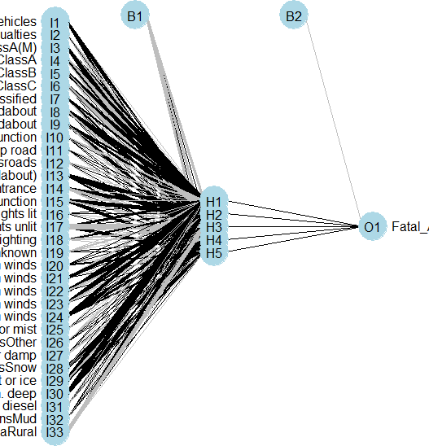
Artificial Neural Networks – R
Plots of networks can be produced
R code
library(NeuralNetTools)
plotnet(nn5)
We note that some labelling is poor!

Slide 36
Interpretation of ANNs
The lines represent the weighted vectors between the neurons
The “B1” and “B2” represents the bias added
Even though ANNs can be very powerful, it is not easy to directly interpret them
This means that we usually have to treat Neural Network models like black boxes
If you want to have a better understanding of relationships then statistical techniques such as logistic regression can be more helpful

